Slide 1

IUBAT-International University of Business Agriculture and Technology
Course Name : Public Speaking
Course Instructor : M. S. Mahmod
Course Code : ENG 250
Prepared By
Md Munna Mia
ID : 21203058
Department Of Computer Science And Engineering

Slide 2
Can Ragging in Universities be Stopped?
How So?
2
Notes:
© Copyright PresentationGO.com – The free PowerPoint and Google Slides template library

Slide 3
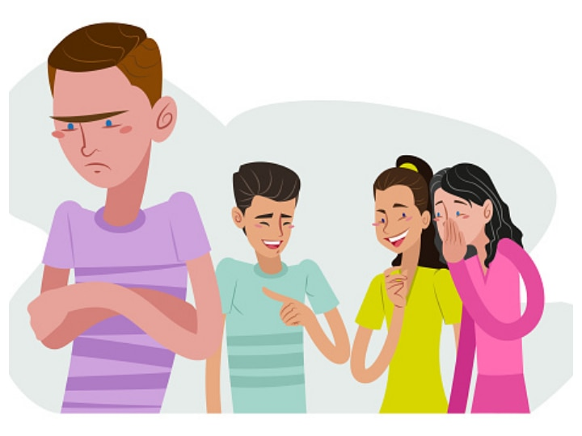


What is Ragging ?
Ragging means playing practical jokes on somebody or teaching someone a lesson.
Ragging involves abuse, humiliation, psychological, physical torture or harassment of new entrants or junior students by the senior students.
Notes:
© Copyright PresentationGO.com – The free PowerPoint and Google Slides template library

Slide 4
How To Stop Ragging
In
University ?
4
Notes:
© Copyright PresentationGO.com – The free PowerPoint and Google Slides template library

Slide 5



Some ways to stop ragging in universities
Counselling – Most of the students aren’t that open with their parents and friends to talk about the problems that they are going through.
Notes:
© Copyright PresentationGO.com – The free PowerPoint and Google Slides template library

Slide 6


CCTV – Lately some of the universities are installing this move of technology but we believe that each and every university must have CCTV cameras installed in classrooms, washrooms, corridors and playgrounds and so on.
Notes:
© Copyright PresentationGO.com – The free PowerPoint and Google Slides template library

Slide 7


Anti-Ragging Squad in campus -
A team of students, as well as teachers, can be formed in the university to fight the evil of ragging.
Here goes the subtitle of your section
7
Notes:
© Copyright PresentationGO.com – The free PowerPoint and Google Slides template library

Slide 8
Punishments
Ragging happens when the culprit knows he cannot be touched. Until or unless the Anti-Ragging law is strictly imposed, such cases will keep on coming to the front.
Interactions between seniors and juniors
Promoting healthy interactions between seniors and juniors can create a positive environment. College can host various activities which help university students to break the wall.
8
Notes:
© Copyright PresentationGO.com – The free PowerPoint and Google Slides template library

Slide 9

9

Slide 10

10

Slide 11
ANY QUESTION?
11
Notes:
© Copyright PresentationGO.com – The free PowerPoint and Google Slides template library

Slide 12
Thank You!
12
Notes:
© Copyright PresentationGO.com – The free PowerPoint and Google Slides template library

